Slide 1
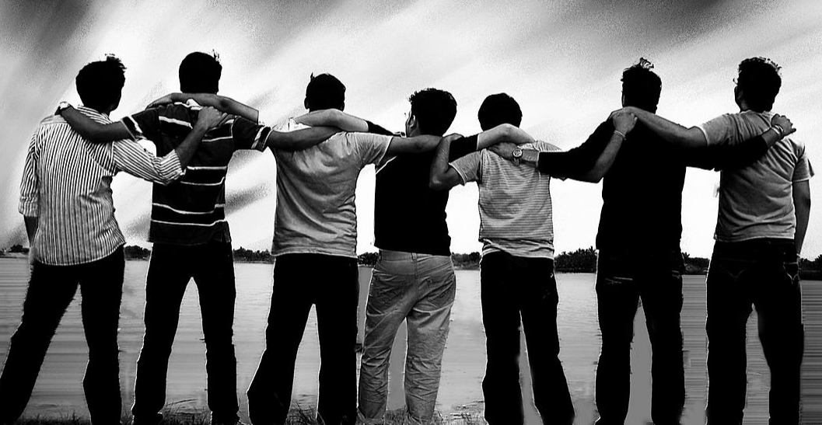
Managing Grief

Slide 2
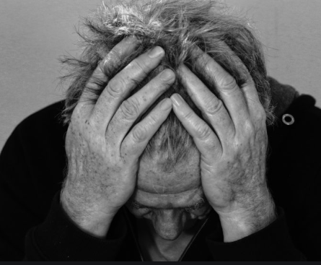
What does grief mean?
What is a bereavement?

Slide 3
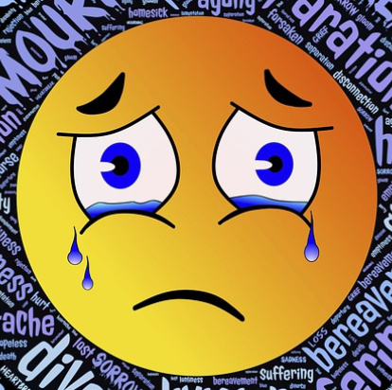
Discuss as a small group the different type of ‘loss’ you might experience during your life.
Put these experiences in order from most serious to least serious.
Why have you ordered them in this way? What aspects of the more serious forms of grief are missing from the less serious?
Do you have an experience like any that have been described?
How might experiencing some of the losses described effect you personally? How would you feel emotionally, spiritually and how might it affect your physical and mental health? How might it affect your purpose and meaning in life?

Slide 4
Responding to others
How might you go about responding to a friend or somebody who you know that might be going through a bereavement or grief over a loss of someone/something?
Role play a simple scenario between two friends, where one has experienced a loss, to demonstrate the types of responses that might be appropriate.
Which virtues might you exhibit in your response to someone in grief?
Why are those virtues so important when someone is experiencing grief and pain?

Slide 5
Pain to sadness
Watch the video interview with the Speakmans about the stages of grief and answer the following questions
Do you agree that grief is a journey from pain to sadness? Why or why not?
Why is a person’s death not the end, according to the woman in the video?
Explain the advantages and disadvantages of considering grief as a journey.
Do you agree with the woman’s statement that a loved one’s death is ‘not the end’?
Are there any positives that can come from grief?

Slide 6
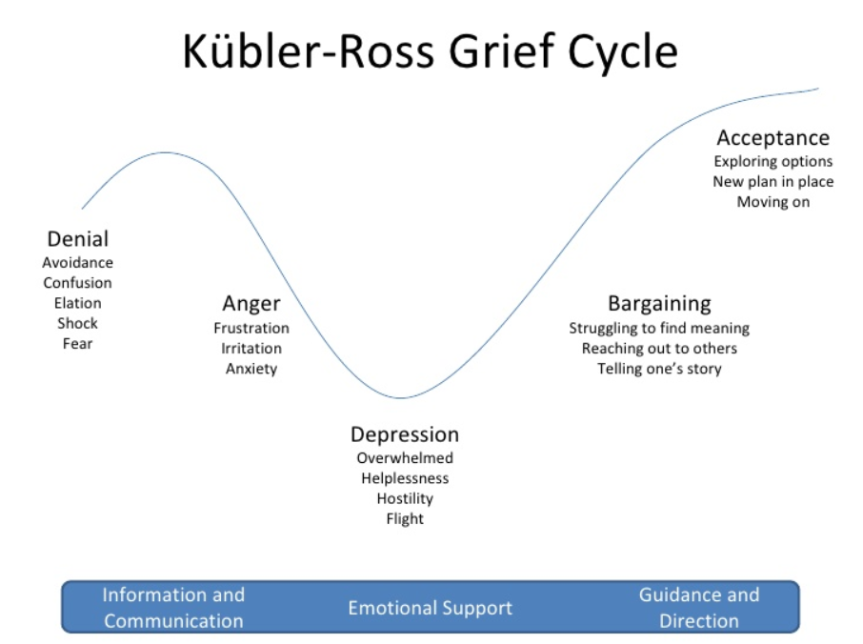
Five stages of grief
Grief manifests itself in five stages. This is a model designed by Elisabeth Kübler-Ross, a Swiss psychiatrist, which helpfully gives a framework for the emotions and journey that people experience when losing someone in their life.

Slide 7
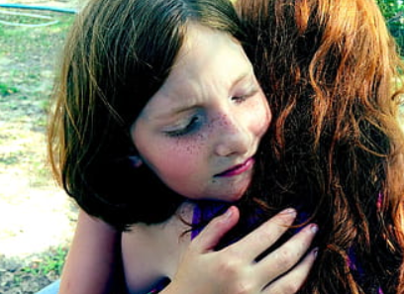
This is a description of how the framework might help someone.
The five stages, denial, anger, bargaining, depression and acceptance are a part of the framework that makes up our learning to live with the one we lost. They are tools to help us frame and identify what we may be feeling. However, they are not stops on some linear timeline in grief. Not everyone goes through all of them or in a prescribed order. The hope is that with these stages comes the knowledge of grief’s terrain, making us better equipped to cope with life and loss. At times, people in grief will often report more stages. Just remember your grief is as unique as you are.
Read through the five stages on the PowerPoint and discuss with a small group what a person might do or say in each of these stages.

Slide 8
Elizabeth Davidson’s story
Read through the story of Elizabeth Davidson who tragically lost her daughter in a car accident.
What stages of grief do we hear in what Elizabeth Davidson has to say about her daughter?
Thinking back to what you discussed about responding to grief in your own lives and the lives of others, would you add anything to your observations based on what you have heard in this case study?

Slide 9
Case Study
Read through the case study with Ellen and try imagine how you would respond to her situation.
Hi my friend, sorry it’s taken me such a long time to get in touch but I’m still trying to get to grips with what has happened. My emotions are so up and down and I feel so angry at losing my brother. The rest of my family just seem to cry and I feel so mad! What do you think? I don’t know if what I’m feeling is normal. How long will this process take do you think? Sorry to be a pain but I knew I could turn to you.
Love
Ellen
Write Ellen a message in response. Your message must be detailed, describing the stages of grief, what Ellen is likely to experience and the best ways you can support her.
Use some of the new terminology that you’ve learned today in your response and why particular activities might be helpful for her grieving process.

Slide 10
If you are struggling, it might be a good idea to contact someone at school, even if this is just to make someone aware of your situation.
If you or someone you know would like support, someone to talk to, or even just a bit of advice, these websites might be a good place to start:
www.childbereavementuk.org
www.griefencounter.org/teen-zone
www.getconnected.org.uk

